Slide 1


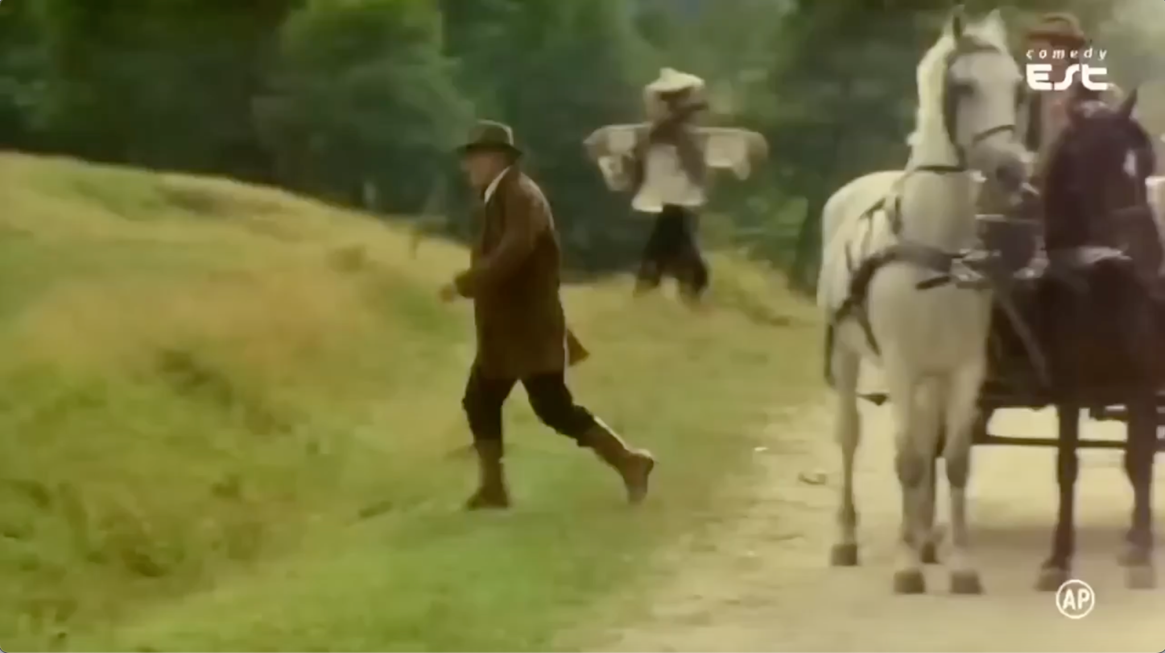
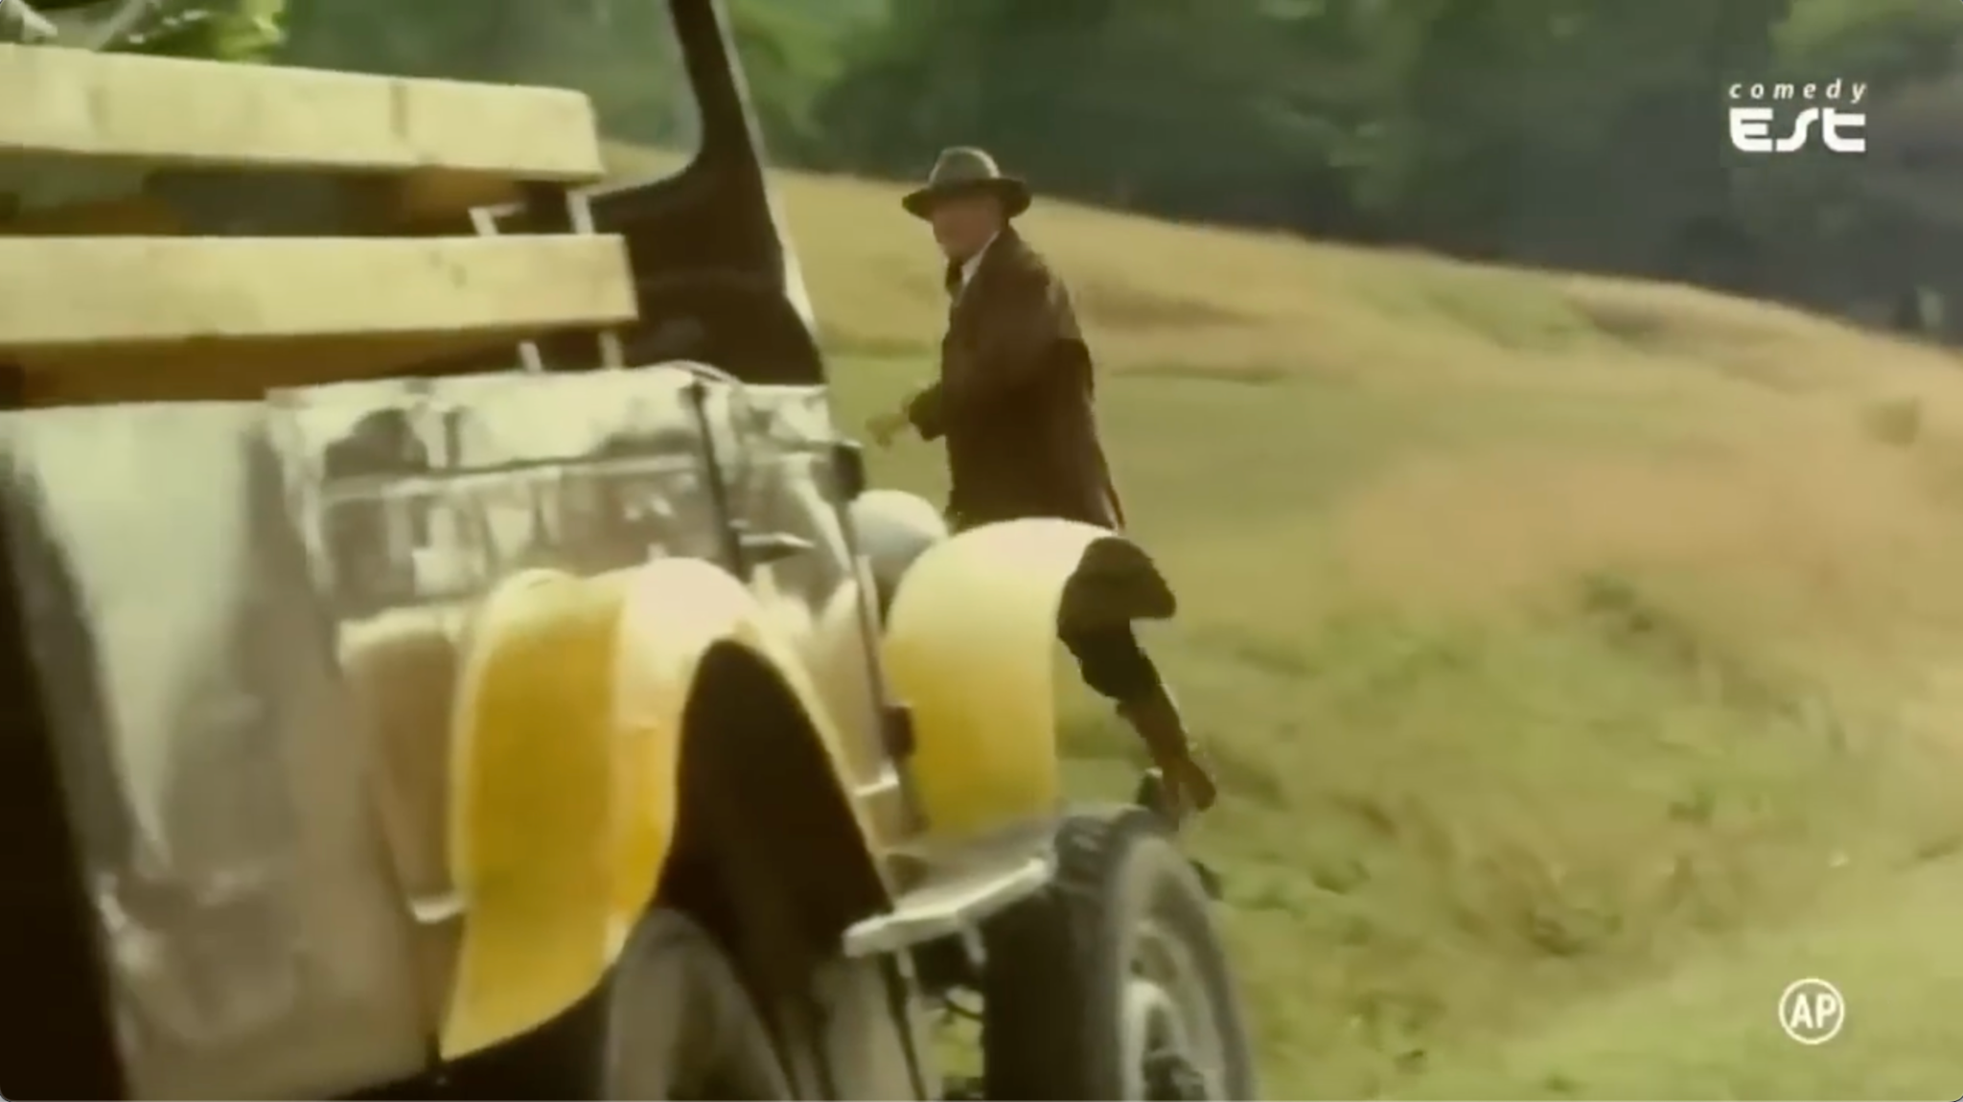
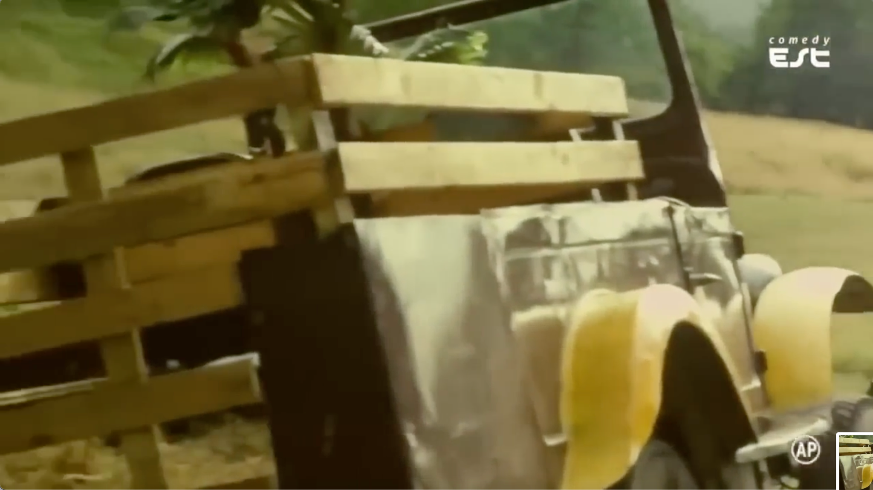
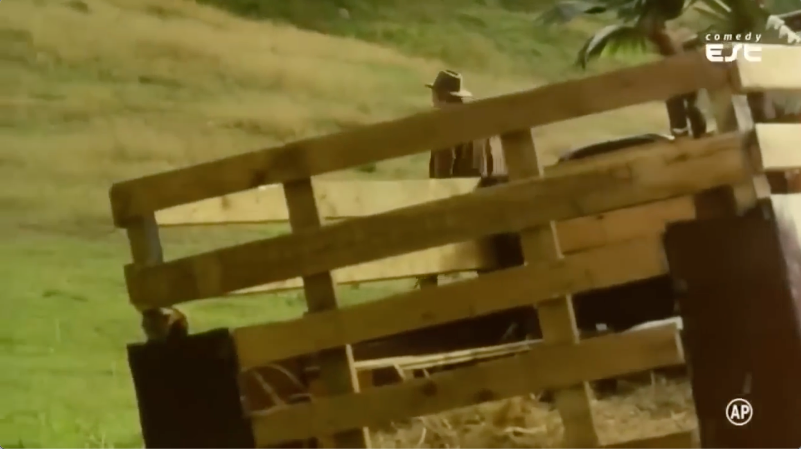
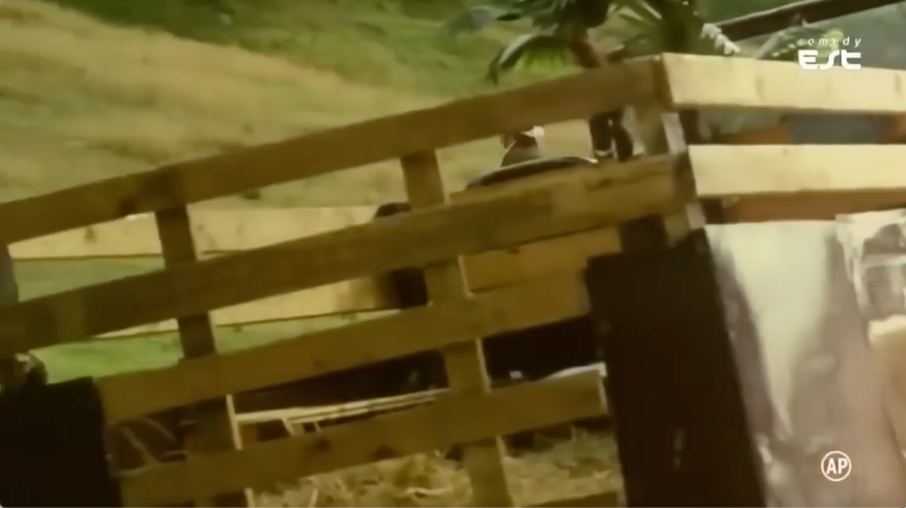
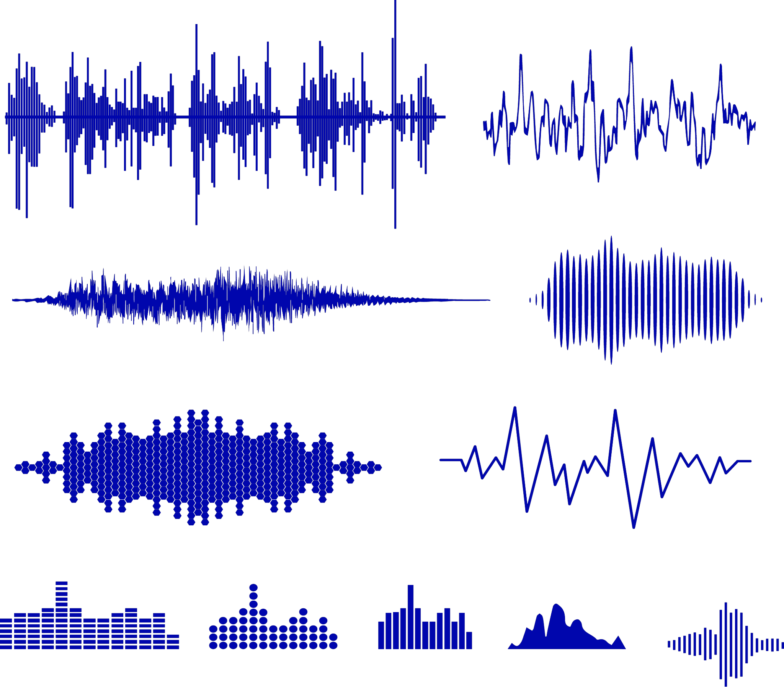



Video Caption: "The video appears to be a time-lapse or montage of a person walking through a grassy field with a horse, showcasing the changing weather conditions and the horse's movement."
OCR
Frame caption: "man walking a white horse down a path. a close - up of the back end of an old car. a person standing on top of a wooden fence.
Dur.
OF
Music Caption: "The low quality recording features a flat male vocal talking, after which there is a wooden percussion playing. The recording is noisy and in mono."
IQ
AES
Objects:"truck","horse","man","fence","grass"
Background: "dark"
Dataset Average
This Clip
Merged Caption: "In a picturesque grassy field, a man walks alongside a graceful white horse, capturing the changing weather conditions and the horse's elegant movements. The scene is set against a backdrop of rolling green hills and a wooden fence, with an old car parked nearby. The video features a low-quality recording of a flat male vocal and wooden percussion, adding a rustic touch to the scenery."

Slide 3



Frame Extraction
A1 the word ...
A2 an image of …
A3
a black
…
In April 2022, experience the thrill of Waterman, a captivating event that promises to leave you spellbound. Set against a dark background, the video features an empty room with a dark background, a black background with a white line on it, and the word \"waterman\" written in white letters on top of a brown background. The captivating instrumental music, with a medium tempo and emotional melody, adds to the sense of anticipation and excitement. The video is sure to leave a lasting impression, making it a must-see in theaters this April.
Image Captioner
Prefixed Instruction Format: Bellow is a video description. This Video [A1], then [A2], [A3]. Its background [C] and objects [C], with background music [D] ….
LLM
Caption B: The video appears to be a promotional or …
MLLM
Caption C:
objects: Waterman, ... background: "Dark",
MLLM
Audio Separation
Music Captioner
Caption D: The song is instrumental music, with a medium …
Metadata DB

Slide 4



Source Video Data
Metadata Cleaning
Scene-based clip Separation
Basic Selection
High-Quality Selection
MMTrail-3M
no
no
no
Low Aesthetic Score
Low OCR score
Low Optimal Flow Score …
Abandon
MMTrail-20M

Slide 5
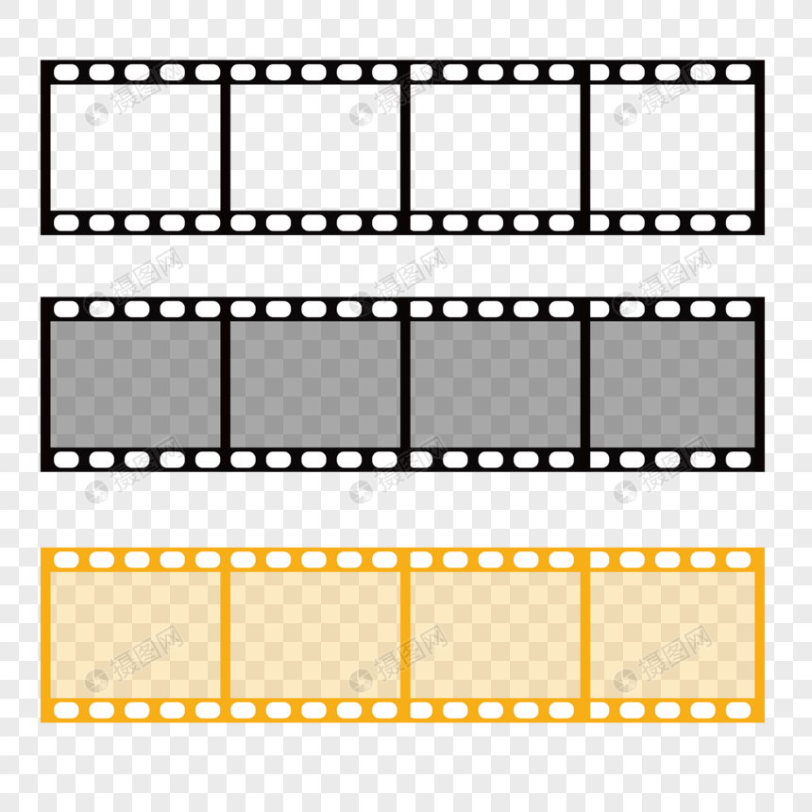


Slide 6
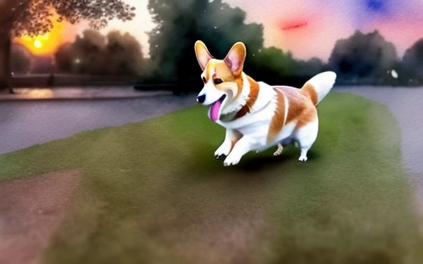
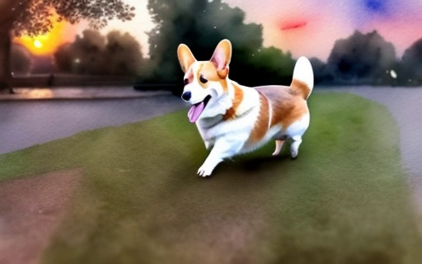
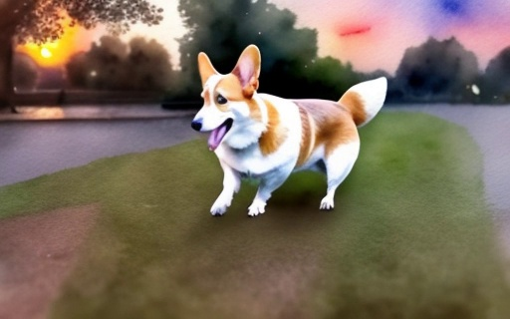
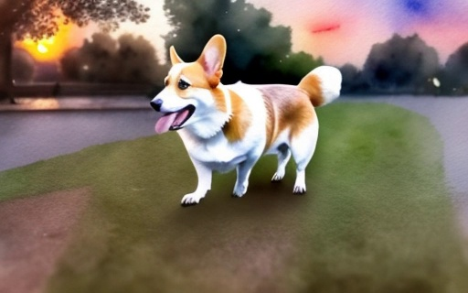
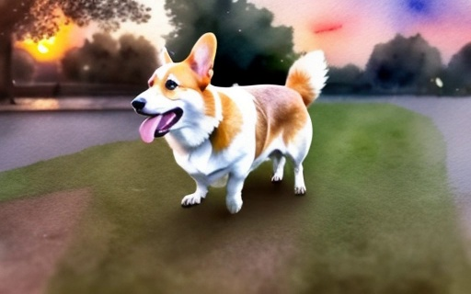
Caption : A cute happy Corgi playing in park, sunset, watercolor painting

Slide 7

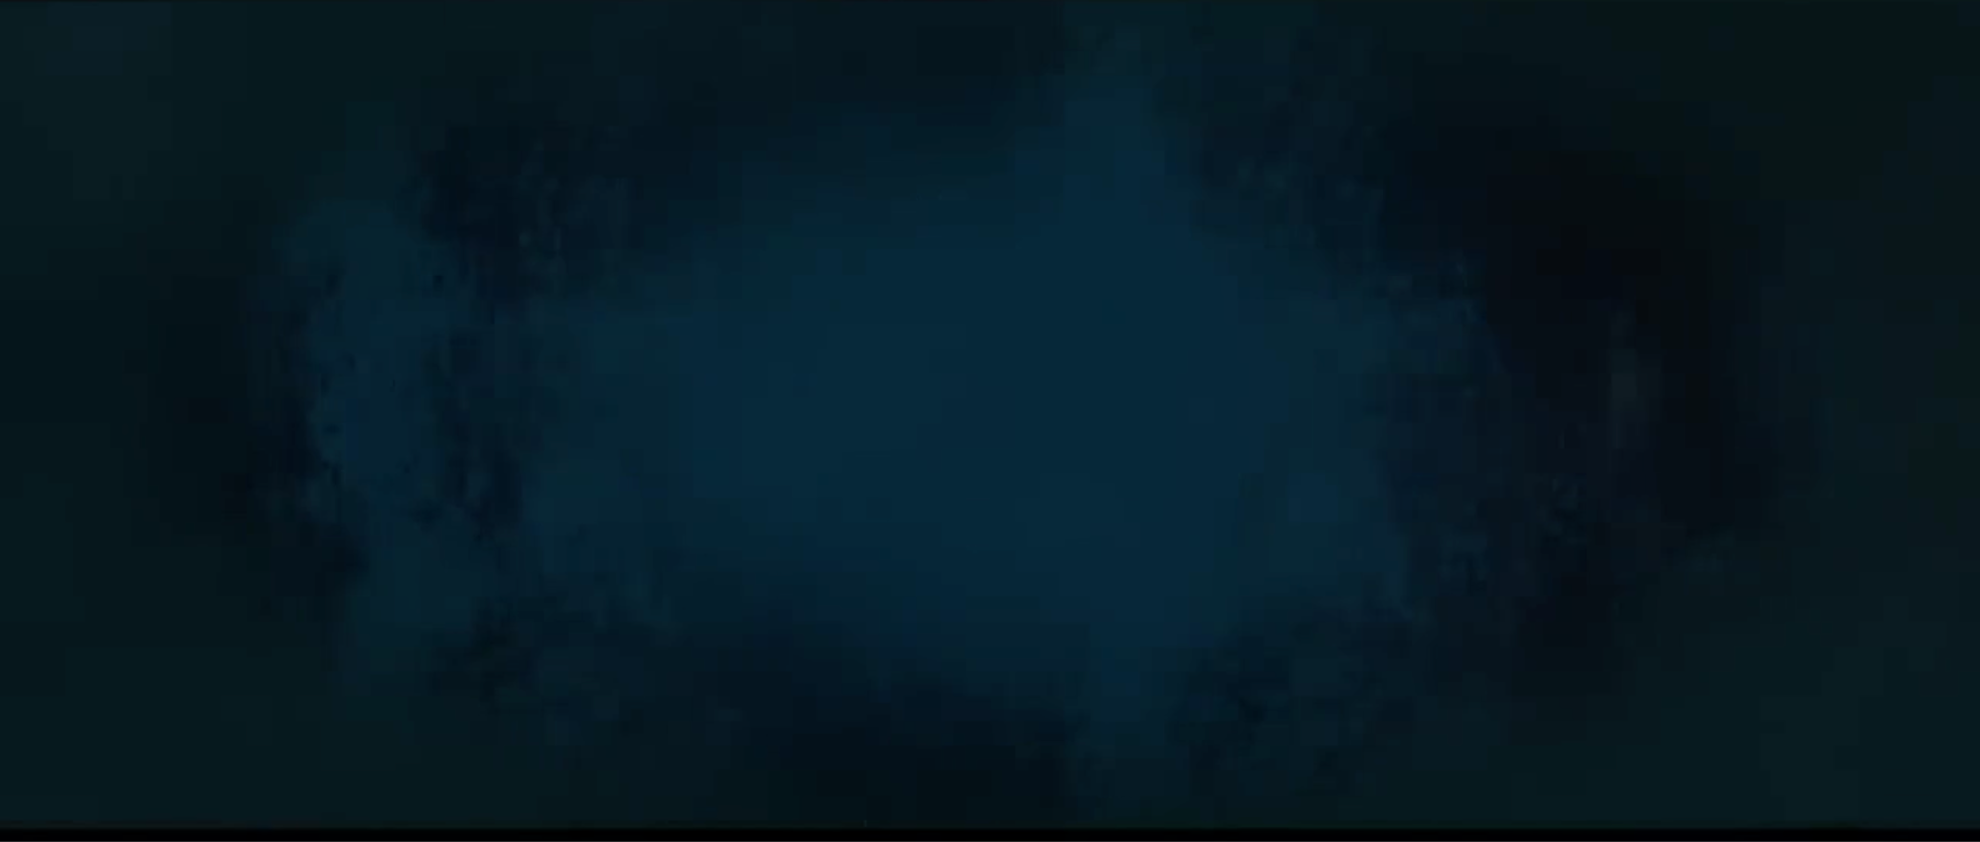
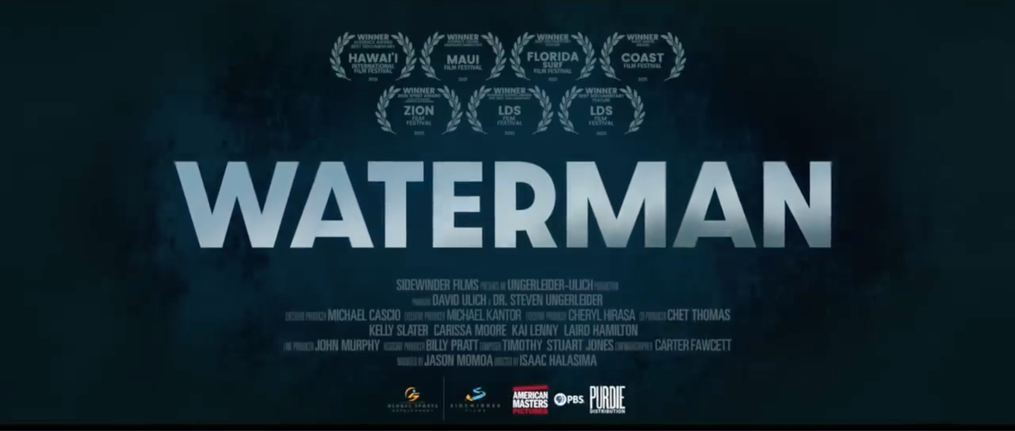


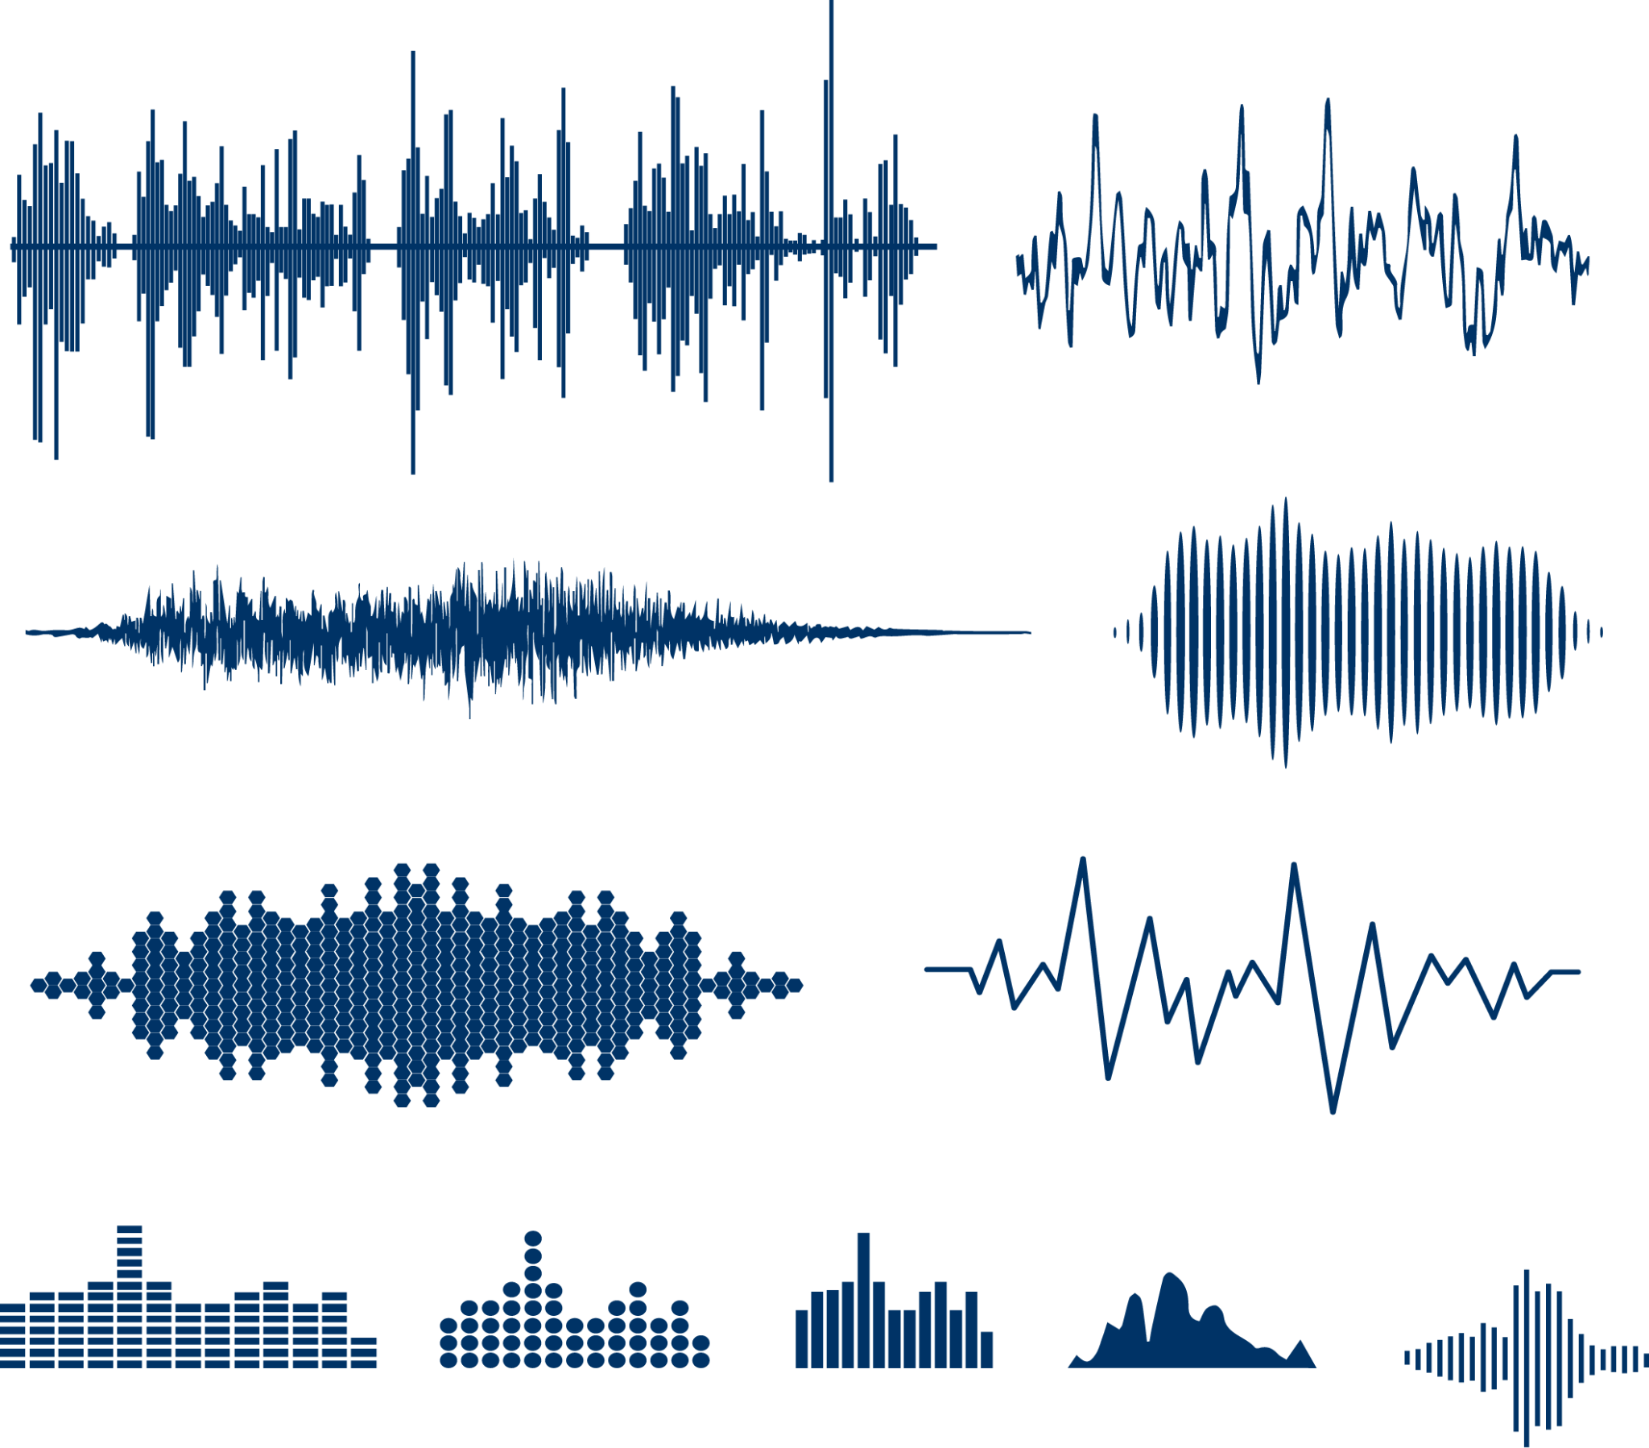
Video Caption: The video appears to be a promotional or informational piece featuring the text \"WATERMAN\" and \"APRIL 2022\" in a stylized manner, suggesting a connection to an event or release related to the name \"WATERMAN\" scheduled for April 2022.
OCR
Dur.
OF
Frame caption: "the word \" waterman \" written in white letters on top of a brown background . ", "an image of an empty room with a dark background . ","a black background with a white line on it . "
Music Caption: The song is an instrumental. The tempo is medium with a string section harmony with strong bass line, rhythmic acoustic guitar accompaniment and keyboard accompaniment. The song is emotional and has a lot of spirit.
objects: " exclusive","Waterman"," April 2022", " in theaters"," movie poster"
background: "Dark",
IQ
AES
Dataset Average
This Clip

Slide 8

The video appears to be an educational or informative piece, possibly related to health or wellness, discussing the concept of "Fear of One's Own Vitality" and "Traditional Talk Therapy" as methods for addressing this fear.

Slide 9
Dur: 13.8
IQ: 50.3
OF 10.28
AES 4.5
OCR 0.0254
Dur: 13.68
IQ: 43.64
OF 8.505
AES 4.135
OCR 0.0065

Slide 11
Average word number
Human Eval Score

Slide 12
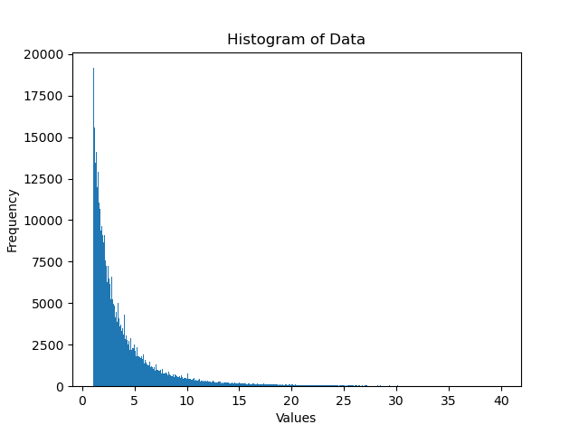
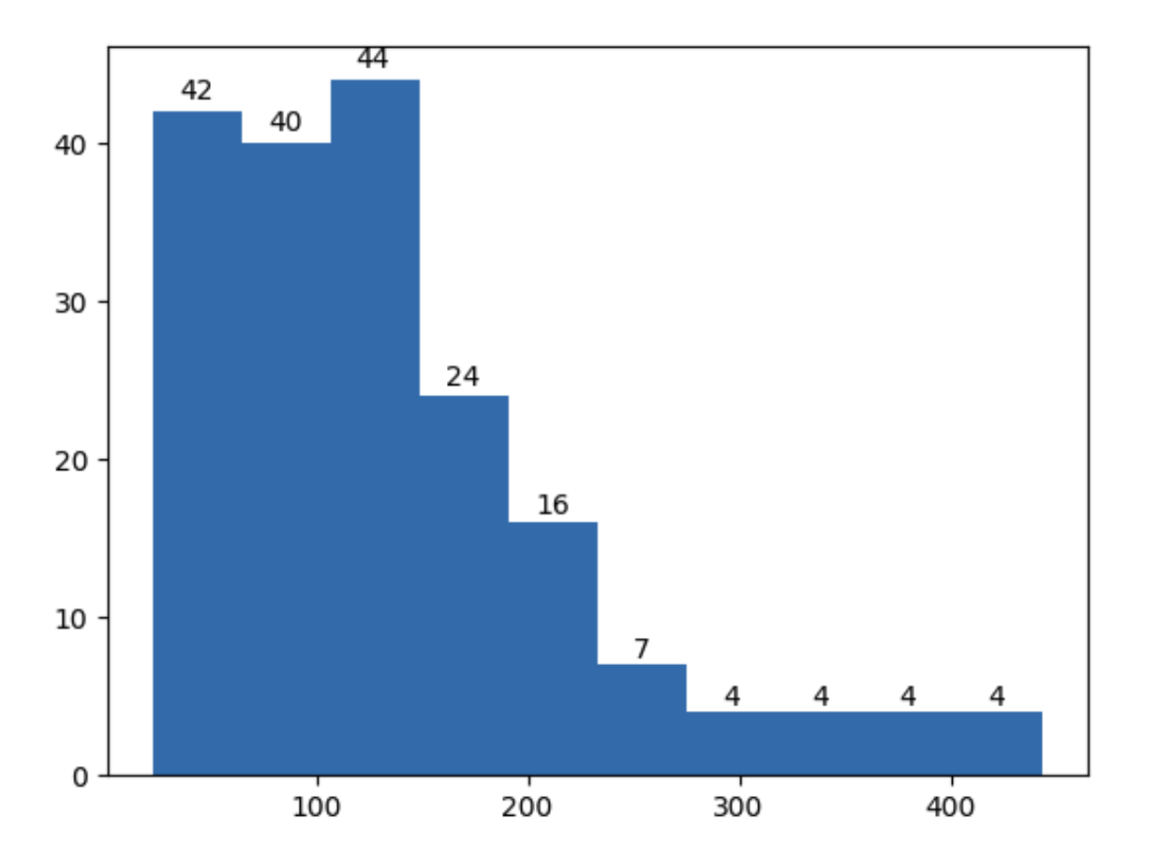
Dataset
85 video groups Youtube Trailer
30w YouTube Video
30M clips
初步统计一个大包：
403608 clips ～ 280G ～ 23.4天
平均 5s / clip, 136s / trailer video
40s以内clips占99.15%
Clips | Trailer Video 数据分析
clips ≦ 40s 分布直方图 | Trailer Video 时长分布直方图（看一下比例）
Notes:
adp: except the threshold isn’t fixed, but is a rolling average of adjacent frame changes.
Threshold the average change in pixel intensity must exceed to trigger a cut.

Slide 13
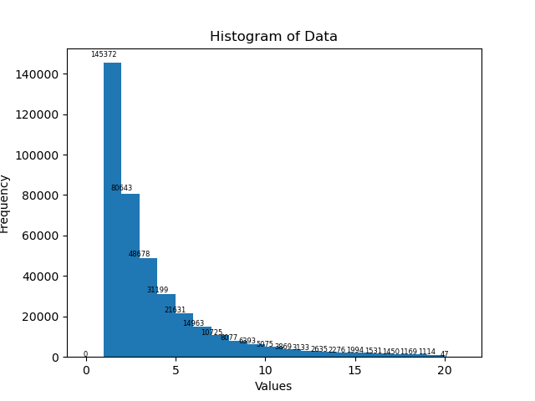
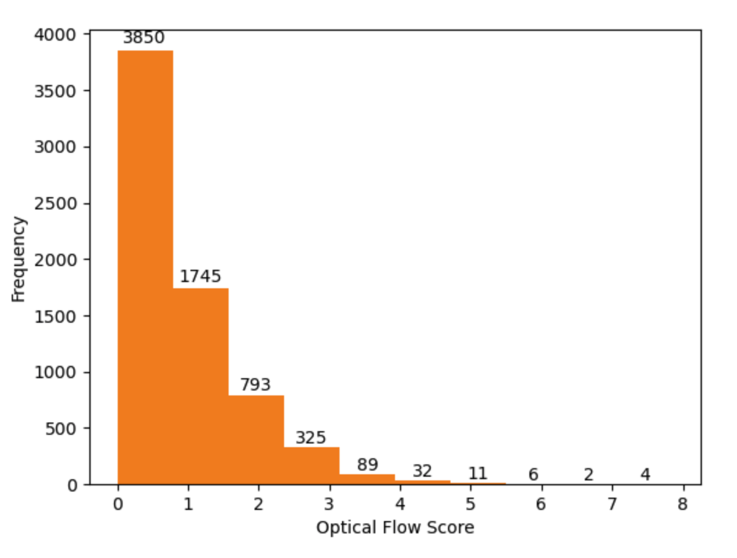
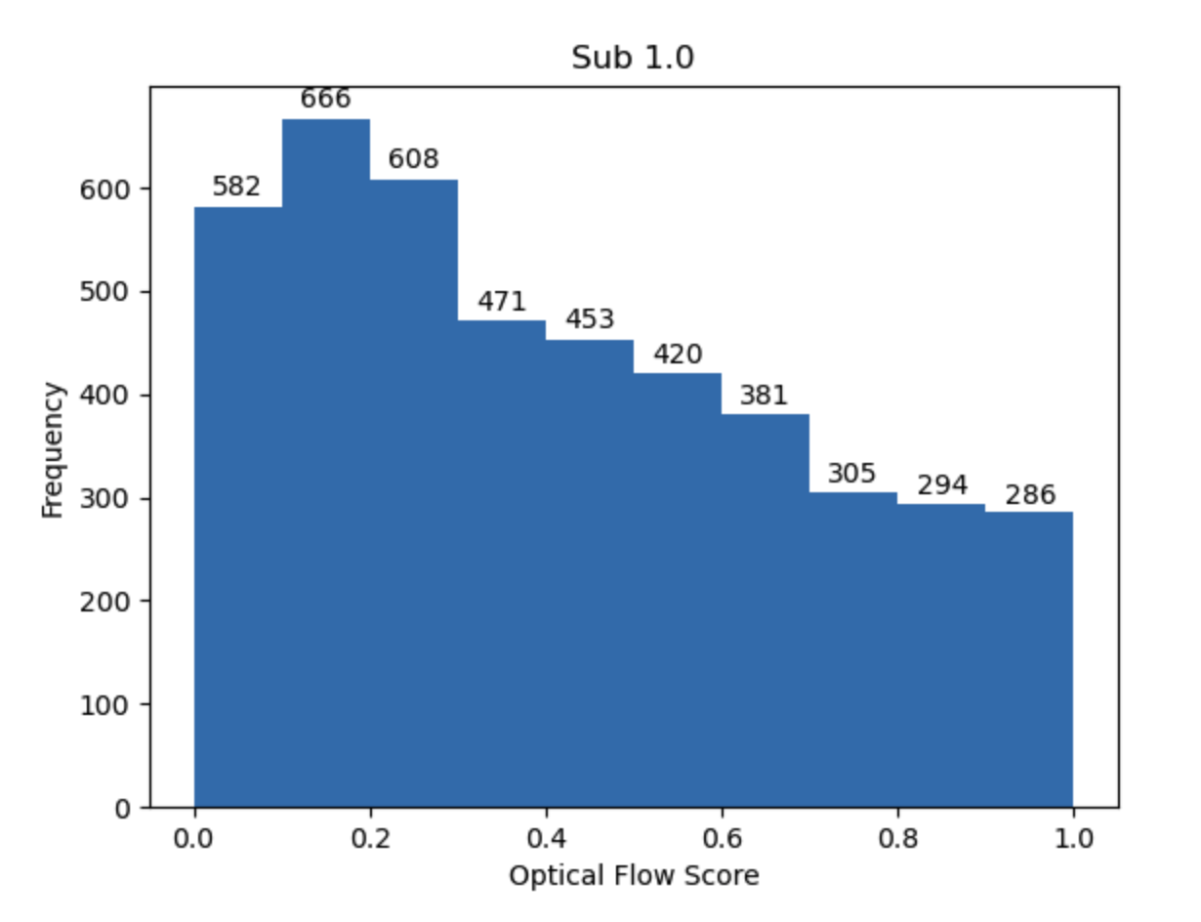
Dataset
20s 内每秒的视频数量统计图
光流分数分布 （下图以 Total# 6k 为例）
统计视频脚本（需针对目的数据进行适当修改）：https://github.com/litwellchi/lvm_datapipe/blob/main/analyze_vids.py
Notes:
adp: except the threshold isn’t fixed, but is a rolling average of adjacent frame changes.
Threshold the average change in pixel intensity must exceed to trigger a cut.

Slide 14
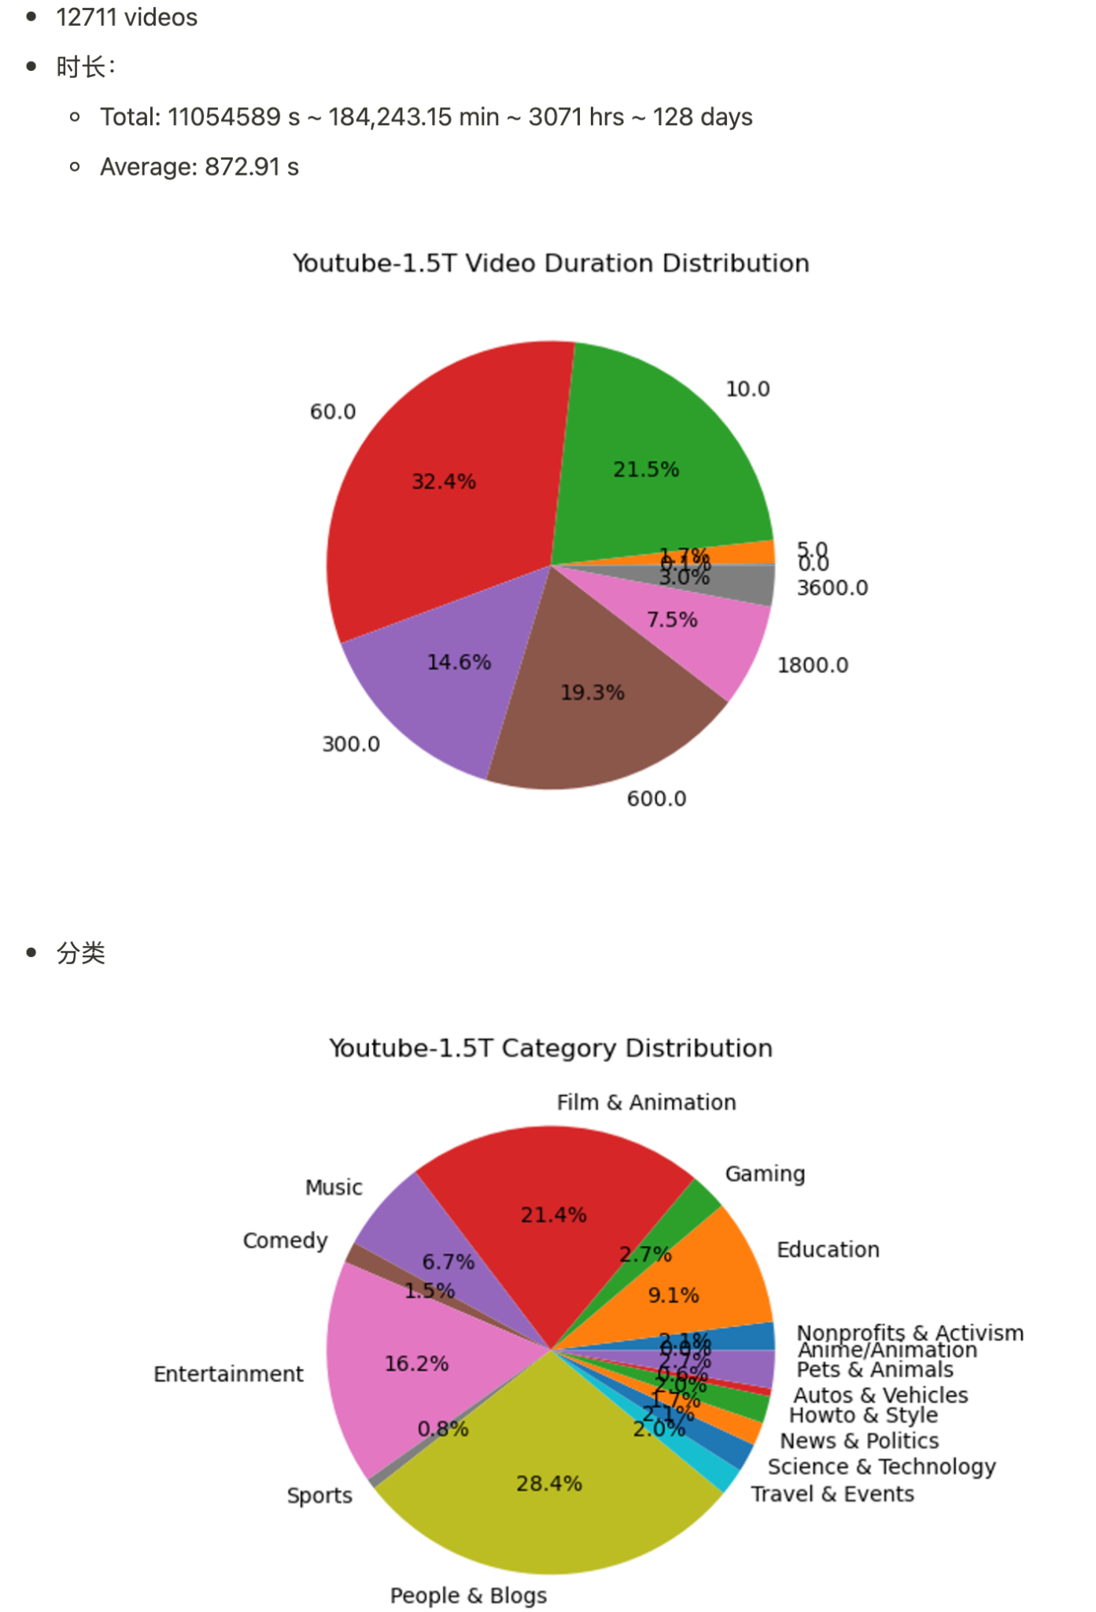
Dataset - YouTube1.5T

Slide 15
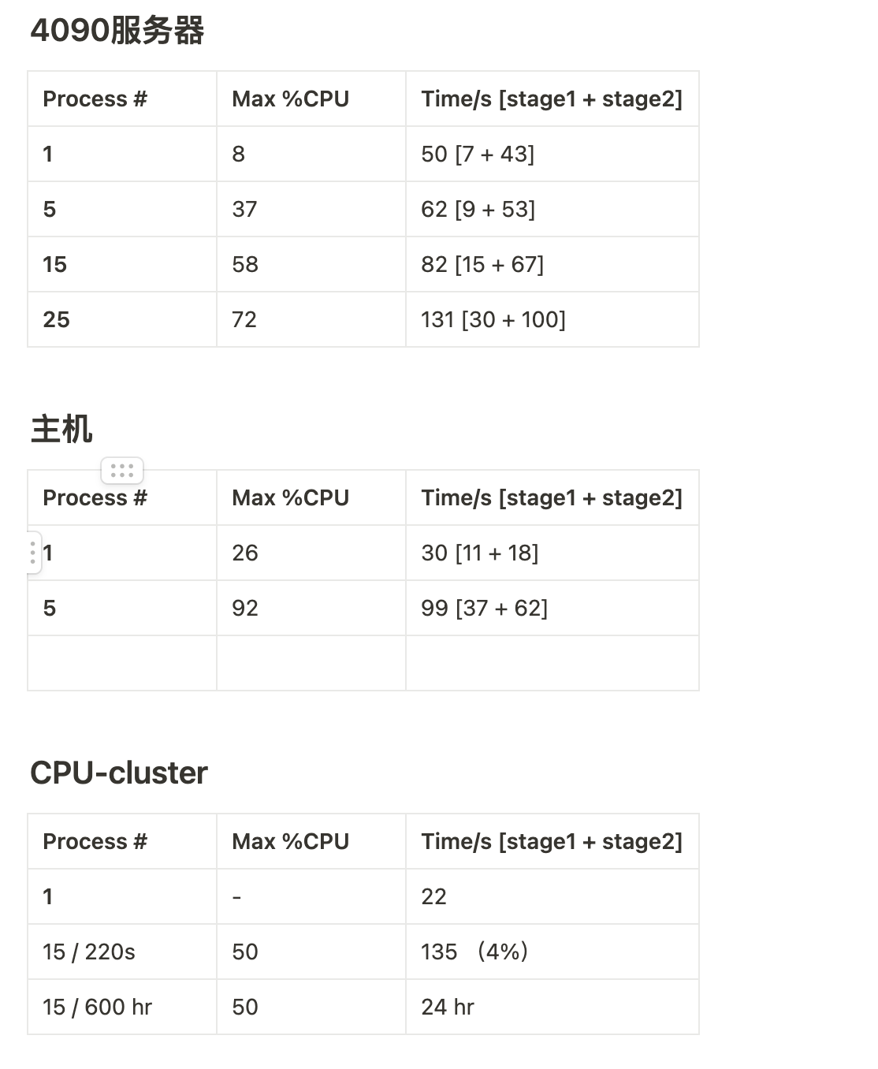
SceneCut
PySceneDetect.content_detector
Generate clips & basic metadata
Progress: Finished
代码：https://github.com/litwellchi/lvm_datapipe/blob/main/SceneCut.py
处理效率：

Slide 16
Caption
Frame-level caption: CoCa
Progress: finished
代码：https://github.com/litwellchi/lvm_datapipe/blob/main/coca.py
python -m torch.distributed.launch --nproc_per_node=8 lvm_datapipe/coca.py --video_path /data/shared_zipdata/video_dataset_"$arg" --world_size 8 --batch_size 40 --num_workers 8

Slide 17
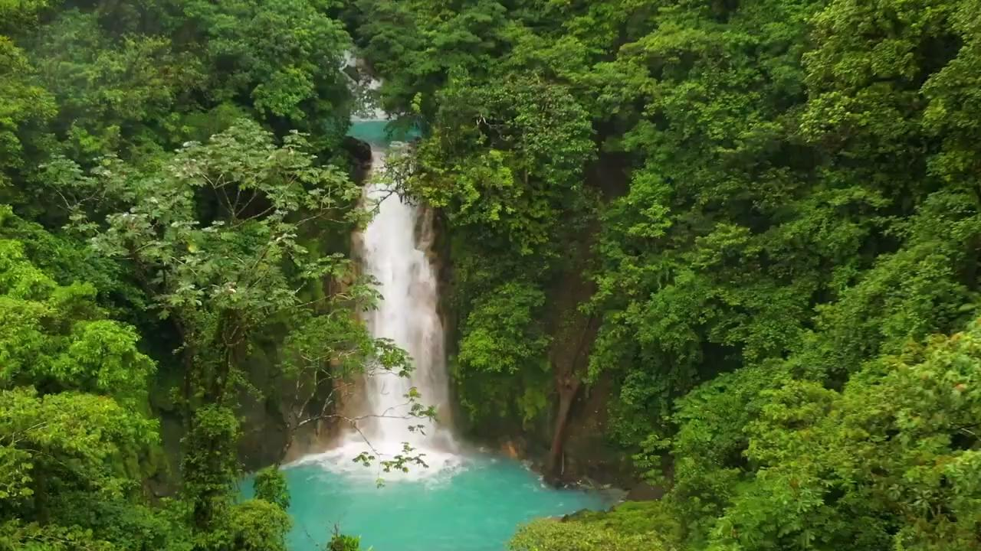
"frame_caption":
a large waterfall surrounded by trees and a body of water .
a waterfall surrounded by green trees and bushes .
a waterfall in the middle of a lush green forest .
"video_blip": "a waterfall in the jungle - waterfall stock videos & royalty-free footage",
"gpt4": Content "The content described in these images is a scenic view of a waterfall within a lush, green forest. The waterfall is the central feature, surrounded by dense vegetation. Category The category of the content in the images is nature and landscape photography. Action There is no human action such as running, dancing, or playing guitar depicted in the images. The only action is the natural movement of the water falling, which is not human-generated and therefore not categorizable by such activities. Speed Although the images are static and do not show motion, if we were to imagine the scene in real-time, the action speed of the water falling could be described as fast due to the force of gravity on the water as it descends. Description The images show a natural landscape focusing on a waterfall. The falls emerge from the top of a cliff or rock formation, hidden by the dense foliage of the forest, and cascade down into a vibrant turquoise pool below. The water's flow creates a misty atmosphere around the area where the water impacts the pool. The forest is rich with various shades of green, indicating a healthy, possibly tropical environment. The overall scene is tranquil and pristine, with the water acting as a dynamic element within the stillness of the forest. The images may have been taken during the day under natural light, which softly illuminates the scene and enhances the lush colors of the environment.
5 prompts for GPT4: 1. What is the content described in these images?
2. Please tell me the category of the content in the images.
3. Please tell me the action of the images such as run, dance, play guitar.
4. Please describe the action speed of the images with very slow,slow,medium,fast and very fast.
5. Please give me a detailed description about the images.

Slide 18
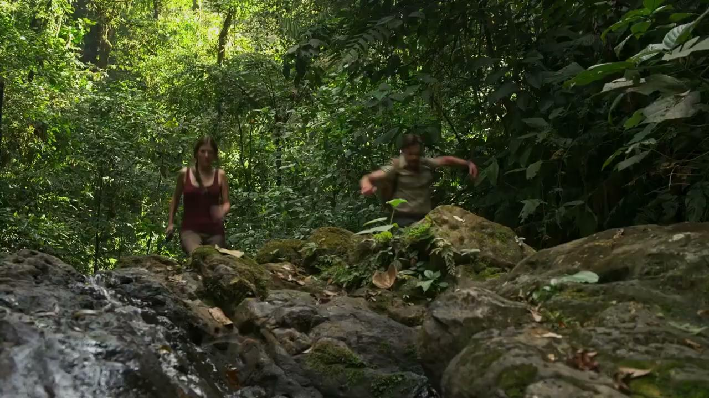
"frame_caption":
a man and a woman running through the woods .
a man and a woman running through the woods .
a man and a woman are running through the woods .
"video_blip": "two people running on rocks in the jungle near a waterfall",
"gpt4":
Content "The content in the provided images depicts two individuals hiking through a dense, lush forest. One person appears to be slightly ahead and is stepping down from a rocky ledge, while the other is in the process of jumping down from the same ledge.
Category The category of this content can be described as outdoor activity, nature, adventure, or travel.
Action The action observed in the images is hiking or trekking, with one individual jumping off a ledge.
Speed The speed of this action would be considered medium, as the individuals are moving with a purposeful pace but not running or moving very fast.
Description For a detailed description: The images show a man and a woman amidst a verdant forest setting, likely on a hiking trail. The forest is densely packed with various species of trees and underbrush, indicating a healthy, thriving ecosystem possibly in a tropical or subtropical region. The sunlight filters through the canopy, casting dappled light on the trail. The woman, dressed in a red tank top and shorts, carefully navigates down the rocky terrain, her expression focused and attentive to her footing. The man, wearing a light-colored shirt and cargo pants, is captured in mid-motion as he energetically jumps down from the rocks, indicating an action-packed moment in their hike. Their active engagement with the challenging terrain suggests they are experienced hikers enjoying the natural surroundings. The images convey a sense of adventure and the pleasure of exploring the great outdoors."

Slide 19
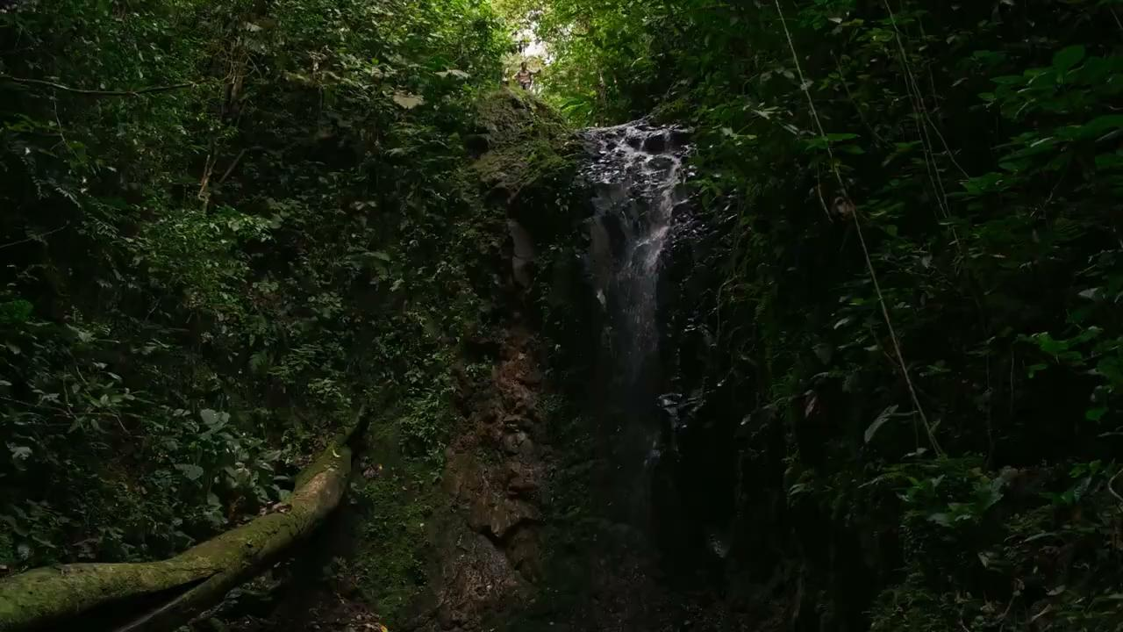
"frame_caption":
a waterfall in the middle of a forest .
a waterfall in the middle of a lush green forest .
a waterfall in the middle of a lush green forest .
"video_blip": "a waterfall in the jungle",
"gpt4":
Content "The content described in these images is a small waterfall located in a dense forest setting. The waterfall appears to be a natural feature within a jungle or forested area, with water cascading down a rock face surrounded by rich vegetation.
Category The category of the content in the images is nature, wilderness, landscape, or outdoor scenery.
Action There is no direct action such as running, dancing, or playing a guitar depicted in these images. The focal point is the waterfall and the surrounding environment.
Speed As there is no human action taking place in these images, the concept of action speed does not apply. However, the water is seen flowing, which would be a continuous and consistent action, generally considered to be of medium speed as it's a natural water flow.
Description For a detailed description: These images capture the tranquil beauty of a secluded waterfall nestled within a thick forest. The waterfall itself is not particularly large or wide, but it provides a serene focal point as the water flows down a rock face. It seems to be a hidden gem, possibly a part of a larger stream or river system, and it has created a small pool at its base where the water accumulates before continuing downstream. The surrounding vegetation is lush and vibrant, with various shades of green from the myriad of plant species present. The forest canopy above is dense, allowing only specks of light to penetrate through, which highlights the natural beauty of the setting. The fallen log in the foreground suggests that this is a wild and untamed environment, potentially far from human habitation. The overall mood of the images is one of peace and natural splendor, inviting viewers to imagine the sound of the water and the coolness of the shaded forest."

Slide 20

"frame_caption":
a person standing in a room with a laptop on their lap .
a man sitting at a table inside of a bank vault .
a close up of a person sitting on a couch in a dark room .
"video_blip": "the man is sitting in front of a clock",
"gpt4": 1
Content The content depicted in these images is a group of individuals seated around a table in what looks like a dimly lit, secure vault-like room with a large ornate door.
Category The category of the content could be described as a cinematic still, possibly from a film or a television series, showing a dramatic or intense scene involving a group discussion or meeting.
Action There is no action such as running, dancing, or playing guitar occurring in these images. The individuals appear to be engaged in a seated discussion or meeting.
Speed The action speed of the images is not applicable as the images capture a still moment with no evident motion, so it would be characterized as \"very slow\" due to the static nature of the scene.
Description A detailed description of the images: We see a wide shot of a room that looks like a secure, bank-like vault with a large, intricate, golden door that is partially open. Inside the vault, there is a room with ornate design elements and a group of four individuals sitting around a table covered with a red tablecloth, seemingly engaged in a serious conversation. The room is dimly lit with soft ambient light, highlighting the golden tones of the vault door and creating an atmosphere of secrecy and importance. The shot composition draws the viewer's attention to the contrast between the opulence of the vault door and the simplicity of the room where the meeting is taking place.

Slide 21
Content The image shows a man in mid-conversation or thought, sitting at what appears to be a dining table or a similar setting. The background is dimly lit with soft, warm lighting, and he is looking slightly downwards with a focused or contemplative expression.
Category The category of the content seems to be a still from a film or television scene, considering the cinematic quality of the image and the expressive demeanor of the man, suggesting a narrative context.
Action The action in the image is not dynamic; it depicts a stationary moment with the man likely engaged in dialogue or reflection, given his facial expression and the setting.
Speed Since the image captures a still moment without any evident motion, it is not applicable to describe the action speed. However, the nature of the captured moment appears to be at rest, without any motion, so it would be characterized as 'very slow' or 'static'.
Description In the detailed description, we see an adult man with a well-groomed beard and hair slicked back, sitting with a slightly slouched posture. He is wearing a light-colored shirt, and his expression is one of seriousness or contemplation. The setting around him is elegantly decorated, with what appears to be a red upholstered chair, a lamp providing a soft glow in the background, and a hint of a dining setting with elements such as a napkin or a table edge in the foreground. The image's mood is thoughtful and somewhat somber, emphasized by the ambient, warm lighting and the subject's introspective demeanor.
第二段gpt4 results ➡️

Slide 22
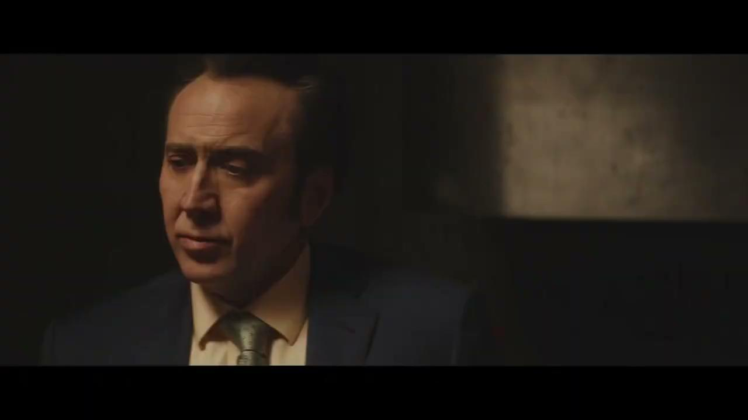
"frame_caption":
a man in a suit and tie looking down .
a man in a suit and a tie .
a man in a suit and tie in a dark room .
"video_blip": "the man in the suit is looking at something",
"gpt4":
Content The content in the images appears to be a man in the middle of speaking or reacting during a conversation. He is dressed formally, indicating that the setting could be a professional or formal environment.
Category The category of the content seems to be a film or television scene, as suggested by the professional quality of the image and the framing of the subject, which is typical of cinematic productions.
Action The action in the images is of the man speaking or reacting. There are no physical actions such as running, dancing, or playing an instrument.
Speed Since the images capture moments of a person speaking, the action speed is not applicable in the context of physical movements. However, if we were to infer the pace of speech or reaction, it would be considered 'medium,' as this is the typical speed for conversation.
Description The images show a middle-aged man with dark hair, wearing a formal navy blue suit with a tie. He appears to be engaged in a conversation, indicated by his open mouth and expressive facial features, which suggest he is either speaking or responding to someone off-camera. The lighting is dim and focused, highlighting the man's face against a dark background, which adds to the intensity of the scene. His facial expressions change slightly between the images, indicating a flow of conversation or a series of reactions. The images convey a sense of drama and narrative progression, characteristic of a movie or TV show scene."

Slide 23
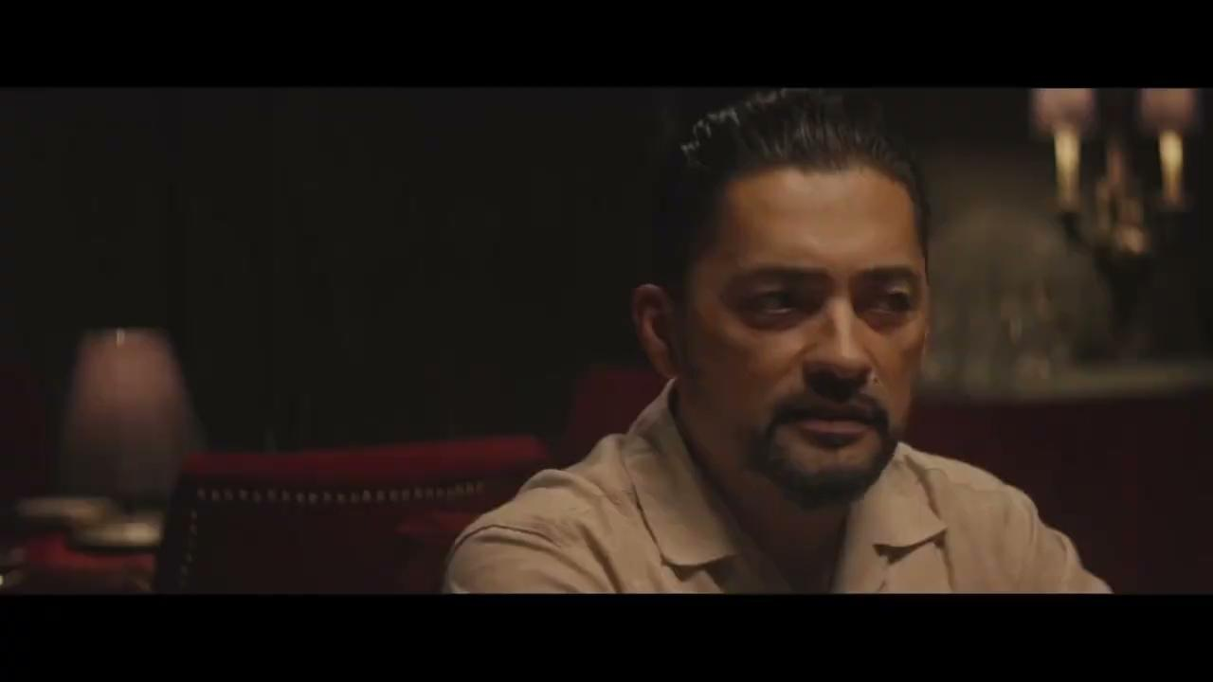
"frame_caption":
a close up of a person sitting on a couch in a dark room
a close up of a person sitting in a chair ,
a close up of a person sitting in a chair
"video_blip": "the man in the beige shirt is looking at the camera",
"gpt4":
Content The content in these images is a man sitting at a table, seemingly engaged in a conversation or listening intently. He appears thoughtful and focused on the discussion.
Category The category of the content is likely a film or television scene, indicated by the cinematic quality and framing of the images.
Action The action depicted in the images is conversational or contemplative; the man is not engaged in any physical activities such as running, dancing, or playing an instrument.
Speed There is no action speed to describe in these images as they capture a still, quiet moment without any discernible movement. If we must assign a speed, it would be 'very slow' or 'static' since the images show no motion.
Description The images show an adult man with a neat beard and slicked-back hair, seated and apparently involved in a conversation. He is wearing a light-colored, collared shirt, which suggests a casual yet neat attire. The setting has a rich, warm ambiance, with a red upholstered chair visible and soft lighting that casts shadows across the scene, adding depth and a sense of intimacy. His expression is one of attentiveness and contemplation, with his eyes slightly averted, as if he's listening or reflecting on what's being said. The overall impression is of a dramatic and potentially serious conversation taking place in an elegant indoor setting."

Slide 24
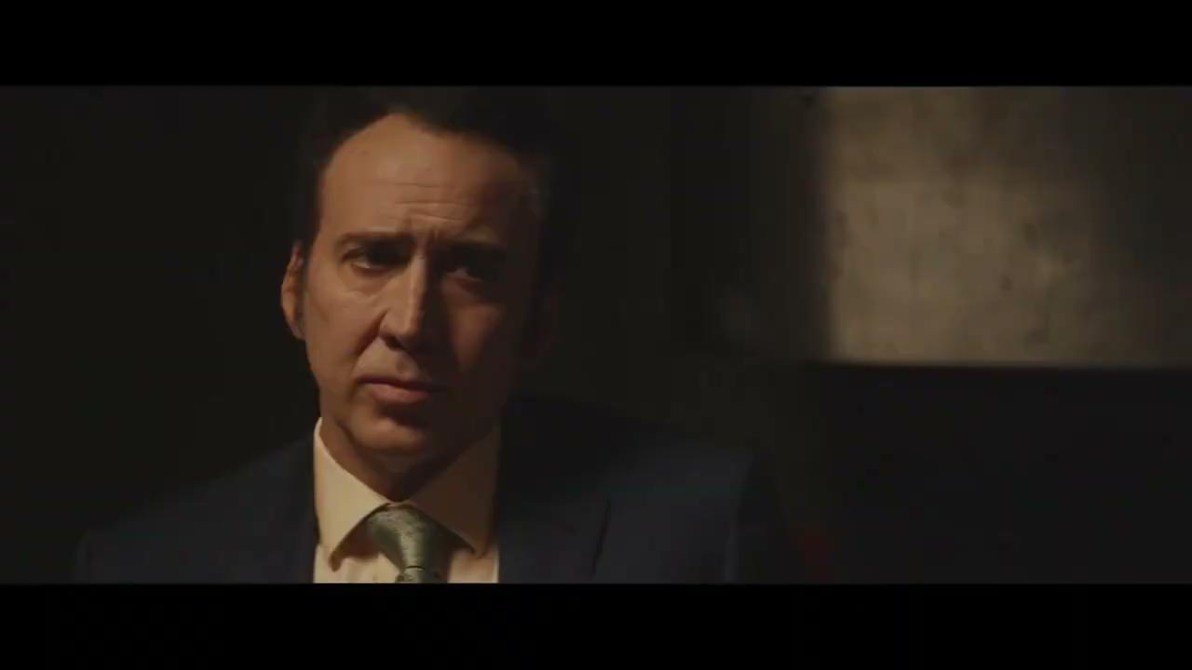
"frame_caption":
a man wearing a suit and tie in a dark room .
a man wearing a suit and tie in a dark room .
a man in a suit and a tie looking to his left .
"video_blip": "a man in a suit and tie
"gpt4":
Content The content in these images shows a man with a serious expression, likely engaged in a conversation or reacting to someone or something. His face is the primary focus, and he appears to be indoors.
Category The category of the content in the images is a film or television scene, as indicated by the professional quality of the images and the framing, which is typical of such media.
Action The action in the images is non-physical; it captures the man's facial expressions, suggesting speaking or reacting rather than a physical activity like running, dancing, or playing an instrument.
Speed The action speed in the images is 'very slow' or 'static' because there is no visible movement, as the images are stills capturing facial expressions.
Description The images provide a detailed view of a middle-aged man with dark hair, wearing a formal navy blue suit and a light-colored shirt with a patterned tie. He appears to be in a dimly lit room, and his facial expressions range from neutral to slightly concerned or pensive. The man's gaze is not directly at the camera but off to the side, suggesting he is engaged with someone or something out of the frame. The mood conveyed by the lighting and his expression is serious and dramatic, characteristic of a pivotal moment in a narrative. The images are tightly cropped around his face, emphasizing his reactions and the emotional content of the scene."

Slide 25
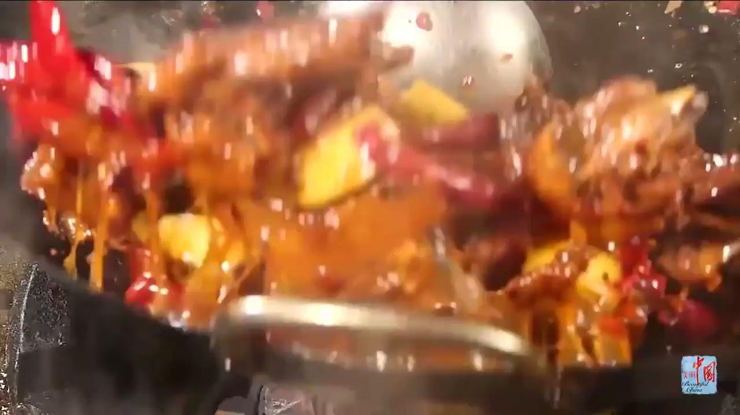
"frame_caption":
a close - up view of a bowl of blue rocks .
a close - up view of a piece of blue glass .
a close - up view of a bowl full of ice cubes .
"video_blip": "i want to learn how to make a chinese stir-fry",
"gpt4":
Content The content in these images is food being cooked, specifically what appears to be a stir-fry with various ingredients sizzling in a pan.
Category The category of the content in the images is culinary or food preparation.
Action The action in the images is cooking, specifically stir-frying, which involves quickly cooking ingredients at a high temperature in a pan.
Speed The action speed of the cooking process in the images can be described as fast since stir-frying is a quick cooking method that involves continuous stirring or tossing of the ingredients.
Description These images depict a lively cooking scene where ingredients are being stir-fried in a wok or pan. There's a vibrant mix of colors from various vegetables and proteins, possibly meat, with pieces visibly coated in a sauce, which suggests a rich, savory dish. The high heat of the stir-fry method is evident from the steam and bubbles in the sauce, and the motion blur of ingredients being tossed suggests a rapid movement. Red chili peppers add a hint of spiciness to the dish, while the glistening sauce implies a flavorful coating. The cook's technique seems skilled, with a controlled yet swift movement to ensure even cooking and to maintain the texture and flavors of the ingredients."

Slide 26
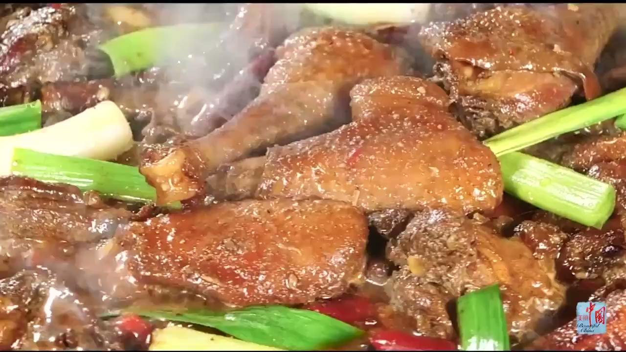
"frame_caption":
a close up view of some blue food .
a close up view of a bunch of green food .
a close - up view of some blue and green food .
"video_blip": "chinese chicken stir-fry",
"gpt4":
Content The content described in these images is a close-up of a dish that is being cooked, which includes meat and green onions, among other ingredients.
Category The category of the content in the images is food and cooking.
Action The action in the images is not of the type that involves running, dancing, or playing guitar; it is the cooking action of stir-frying or braising in a pan or wok.
Speed The action speed depicted in the images would be considered 'fast' because stir-frying or braising is typically done over high heat with quick cooking times.
Description The images show a detailed view of a culinary dish in the process of cooking. The meat, possibly chicken or duck judging by the skin and size of the pieces, is well-browned and coated in what appears to be a savory glaze or sauce, evidenced by the sheen on the surface. Green onions, both white and green parts, are present, adding a pop of color and likely a fresh, aromatic flavor to the dish. The steam and sizzling sound (which can't be seen but imagined due to the cooking process) indicate that the food is being cooked at a high temperature. The images capture the essence of Asian cuisine, with the possibility of spices like chili peppers included, suggested by the red specks present. The cooking technique emphasizes the caramelization of the meat's exterior while maintaining juiciness inside, characteristic of skilled wok cooking."

Slide 27
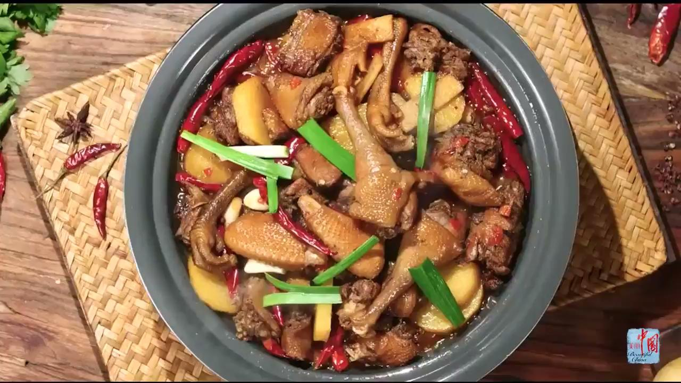
"frame_caption":
a close up of a bowl of food on a table .
a close up of a bowl of food on a table .
a close up of a bowl of food on a table.
"video_blip": "chinese chicken stew recipe",
"gpt4":
Content The content depicted in these images is a dish of cooked food, specifically a traditional Chinese cuisine that appears to be a braised chicken dish with various ingredients.
Category The category of the content in the images is \"food\" or \"cuisine.\"
Action There is no action like running, dancing, or playing guitar in these images, as the subject matter is static food.
Speed Since the images show a non-moving subject, there is no action speed to describe. Therefore, terms like very slow, slow, medium, fast, and very fast are not applicable.
Description The images display a savory Chinese dish consisting of braised chicken pieces, which are likely marinated and cooked until tender. Accompanying the chicken are ingredients such as potatoes and green onions, adding to the flavor and presentation of the dish. The chicken's skin looks glossy, suggesting it may have been cooked in a soy or similar sauce. The dish is garnished with green onion stalks, and whole dried red chilies are present, indicating spiciness. The food is served in a dark bowl, which contrasts with the warm tones of the dish, enhancing its visual appeal. The bowl is placed on a woven mat, and there are some scattered Sichuan peppercorns around, hinting at the use of this spice in the recipe. The overall presentation is appetizing, emphasizing the textures and colors of the ingredients used."

Slide 28
光流
方法
Video2dataset
2%的时间开销
ffmpeg extract_mvs.c
3%的时间开销
根据motion score filtering rules：
None & Nan：
mvs nan: 静态（黑屏）⇒ 去掉
v2d None - mvs nan: 保留
根据两个方法scores差距大的分情况处理
根据Scores绝对值的处理
2 Optical Flow Extraction codes：
https://github.com/litwellchi/lvm_datapipe/blob/main/ffmpeg/
配置步骤：https://github.com/litwellchi/lvm_datapipe/blob/main/ffmpeg/readme.md
Filtering 代码：https://github.com/litwellchi/lvm_datapipe/blob/main/optical_flow_filtering.py

Slide 29
分类 & 美学
分类
目前分类的方法？
统计可视化代码：https://github.com/litwellchi/lvm_datapipe/blob/main/analyze_vids.py
美学
Notes:
adp: except the threshold isn’t fixed, but is a rolling average of adjacent frame changes.
Threshold the average change in pixel intensity must exceed to trigger a cut.

Slide 31
StoryTelling
Show Me a Video: A Large-Scale Narrated Video Dataset for Coherent Story Illustration
https://nfy-dot.github.io/CVSV-dataset/
Dataset：CVSV
Movie Recap
顺序，相对来说故事更完整
8.5w个视频
134.13 seconds / video
60 clips / video
放了414的youtube url：https://www.youtube.com/@movierecapsofficial （已爬取完成了SceneCut）
Why trailers？
解释：故事性强
做靠近trailers这个数据类型的任务：Video summarization等

Slide 32
思路和方向
整体方向
StoryTelling:
目前问题：
youtube trailer的故事性（完整的故事线能不能生成出来）；
主角人物重新识别/规定好的问题（可以通过招人标来解决）；
Interleaved Video Dataset
story作为一个extention
Baselines → 对于 Neurips dataset track 非必须
Understanding
caption：frame / video / tag分类 （题材类型，motion类型）
VQA
Generation
Text2vid clip --> need a baseline
video prompt video, generate following video
Baselines：VideoDirectorGPT, VideoDrafter, < gpt + text2video>;
一致性评价问题
CLIP， SAM提取mask，计算距离：人物一致性 / 场景一致性 + inter/intra clip evaluation
User study
future direction/ limitation 目前没有做的好的工作 ；

Slide 33
Related Works
比较重要的baseline
VIST Dataset: https://visionandlanguage.net/VIST/
Show Me a Video: A Large-Scale Narrated Video Dataset for Coherent Story Illustration
Please review the dataset setting of the following benchmark papers:
MiniGPT-5
Emu
DreamLLM
The Next Chapter: A Study of Large Language Models in Storytelling https://arxiv.org/pdf/2301.09790.pdf
InternVid: A Large-scale Video-Text Dataset for Multimodal Understanding and Generation (13 Jul 2023) Wang, Yi, et al.

